Slide 1
Machine Learning
MATH42815
Tuesday January 9th 2024

Slide 2
Course Outline
Compressed timeline: 4 weeks
Practical sessions:
Monday, Wednesday, Thursday: 9-11 or 11-1
Lectures:
Tuesday, Friday: 5-6
Techniques covered in IMDS and ISDS will come into play
After yesterday’s introductory practical, a base level of knowledge will be assumed
Credit and thanks to (among others) Dr. Sam Jackson, Dr. Konstantinos Perrakis, Dr. Hailiang Du, Prof. Camila Caiado

Slide 3
Week 1
Practical 1:
Revision of IMDS and ISDS techniques
Question Time
Lecture 1:
“Basic” concepts
Practicals 2 and 3:
Forward/back/best subset selection
Predictive performance and cross-validation
Lecture 2:
Ridge, Lasso, and Principal Component Regression

Slide 4
Lecture 1 Outline
How we store higher-dimensional data in computers
What is Machine Learning?
How can things go wrong?
What is a Model?
Important concepts
Combining IMDS and ISDS concepts
Today, there will be relatively little new maths

Slide 5
Tips for My Lectures/Practicals
I will ask lots of questions, and I would appreciate answers
Wrong answers are acceptable!
“I don’t know” is acceptable!
Questions from the floor are permitted
I would not go quite so far as to say encouraged, but if something is unclear you should let me know and I will try to find a better way to explain it, either in the next lecture or in an announcement on Blackboard Ultra

Slide 6
Dimensionality and Data

Slide 7
Data Science: Tidy Data Principles
Much of “data science” involves tables with rows and columns
See tidy data principles
Rows are “observations”
Columns are “variables”
In Machine Learning, every variable is kind of a spatial dimension
Even binary variables can be thought of as a “space” consisting of two discrete points with no connecting space: X = 0 and X = 1
We have seen vectors and matrices, and now we get to learn about tensors
Notes:
Each of these “data sets” represents Arlo. Without appropriate computer programs, we could never identify what Images 2 and 3 represent. Without my nephew having specified that he had drawn “Awo”, I would be surprised if anyone could identify what Image 1 represents. In fact, when his mother asked him a few weeks later what the drawing was, he just laughed nervously. On the other hand, everyone in this room could probably tell what Image 5 represented: a dog. But none of these images fully captures every aspect of Arlo; and even the identifiable image omits all kinds of information (what colour is his belly, for example? How tall is he?). When we collect quantitative data, it is as useful as the RGBK values shown in Image 2. What you will learn in this course are techniques that will let you take those quantitative data, and uncover the information and the knowledge hidden within them; and my goal is to ensure that your representations of those data are at least closer to how Image 4 represents Arlo than Image 1.

Slide 8
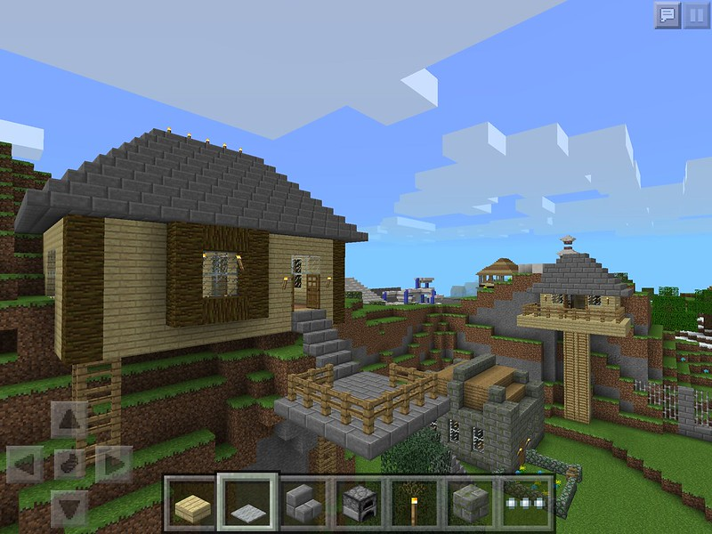
What’s a Tensor?
Scalar: Zero-dimensional, point, single value
Vector: One-dimensional, line, multiple (ordered) values
Matrix: Two-dimensional, indexed grid of values
Tensor: n-dimensional, but for now let’s think about 3D
Notes:
Each of these “data sets” represents Arlo. Without appropriate computer programs, we could never identify what Images 2 and 3 represent. Without my nephew having specified that he had drawn “Awo”, I would be surprised if anyone could identify what Image 1 represents. In fact, when his mother asked him a few weeks later what the drawing was, he just laughed nervously. On the other hand, everyone in this room could probably tell what Image 5 represented: a dog. But none of these images fully captures every aspect of Arlo; and even the identifiable image omits all kinds of information (what colour is his belly, for example? How tall is he?). When we collect quantitative data, it is as useful as the RGBK values shown in Image 2. What you will learn in this course are techniques that will let you take those quantitative data, and uncover the information and the knowledge hidden within them; and my goal is to ensure that your representations of those data are at least closer to how Image 4 represents Arlo than Image 1.

Slide 9
What’s a Tensor?
Scalar
Zero-dimensional, point, single value
Vector
One-dimensional, line, multiple (ordered) values
Matrix
Two-dimensional, indexed grid of values
Tensor
n-dimensional, but for now let’s think about 3D
Notes:
Each of these “data sets” represents Arlo. Without appropriate computer programs, we could never identify what Images 2 and 3 represent. Without my nephew having specified that he had drawn “Awo”, I would be surprised if anyone could identify what Image 1 represents. In fact, when his mother asked him a few weeks later what the drawing was, he just laughed nervously. On the other hand, everyone in this room could probably tell what Image 5 represented: a dog. But none of these images fully captures every aspect of Arlo; and even the identifiable image omits all kinds of information (what colour is his belly, for example? How tall is he?). When we collect quantitative data, it is as useful as the RGBK values shown in Image 2. What you will learn in this course are techniques that will let you take those quantitative data, and uncover the information and the knowledge hidden within them; and my goal is to ensure that your representations of those data are at least closer to how Image 4 represents Arlo than Image 1.

Slide 10
Tensors
It’s much easier to deal with a tensor on a computer than in mathematical notation!
Sometimes it can even be conceptually easier than matrices
Instead of having 2 semi-arbitrarily ordered indices where order can be confusing, every dimension/variable gets its own index
Extremely basic code to create a tensor:
Python: a = np.arange(20).reshape(2, 2, 5)
R: a <- array(seq(1,20,1),dim=c(2, 2, 5))
…ah. We have run into a problem.
Notes:
Each of these “data sets” represents Arlo. Without appropriate computer programs, we could never identify what Images 2 and 3 represent. Without my nephew having specified that he had drawn “Awo”, I would be surprised if anyone could identify what Image 1 represents. In fact, when his mother asked him a few weeks later what the drawing was, he just laughed nervously. On the other hand, everyone in this room could probably tell what Image 5 represented: a dog. But none of these images fully captures every aspect of Arlo; and even the identifiable image omits all kinds of information (what colour is his belly, for example? How tall is he?). When we collect quantitative data, it is as useful as the RGBK values shown in Image 2. What you will learn in this course are techniques that will let you take those quantitative data, and uncover the information and the knowledge hidden within them; and my goal is to ensure that your representations of those data are at least closer to how Image 4 represents Arlo than Image 1.

Slide 11
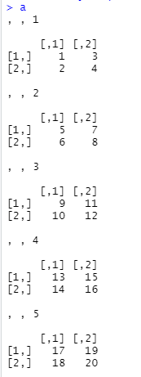
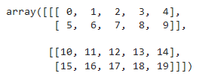
Python and R index variables differently
R
a[1,2,3] = 11
Python
a[0,1,2] = 7
(Remember Python indexes from 0)
We will be working with R!

Slide 12
What Is Machine Learning?
What Is Learning?
What Is Information?
What Is Understanding?

Slide 13
Supervised vs. Unsupervised Learning
Supervised Learning:
One variable marked as “output”
Others are features/inputs/predictors
Everything you have done in ISDS
Examples: regression, classification
Unsupervised Learning:
No “output” variable, all variables treated equally
Examples: k-means cluster, principal component analysis

Slide 14

What Is This (1)?

Slide 15
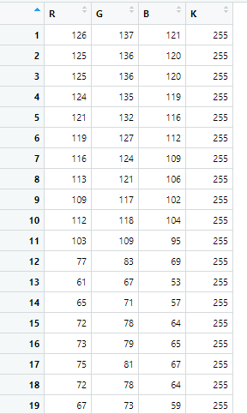
What Is This (2)?

Slide 16
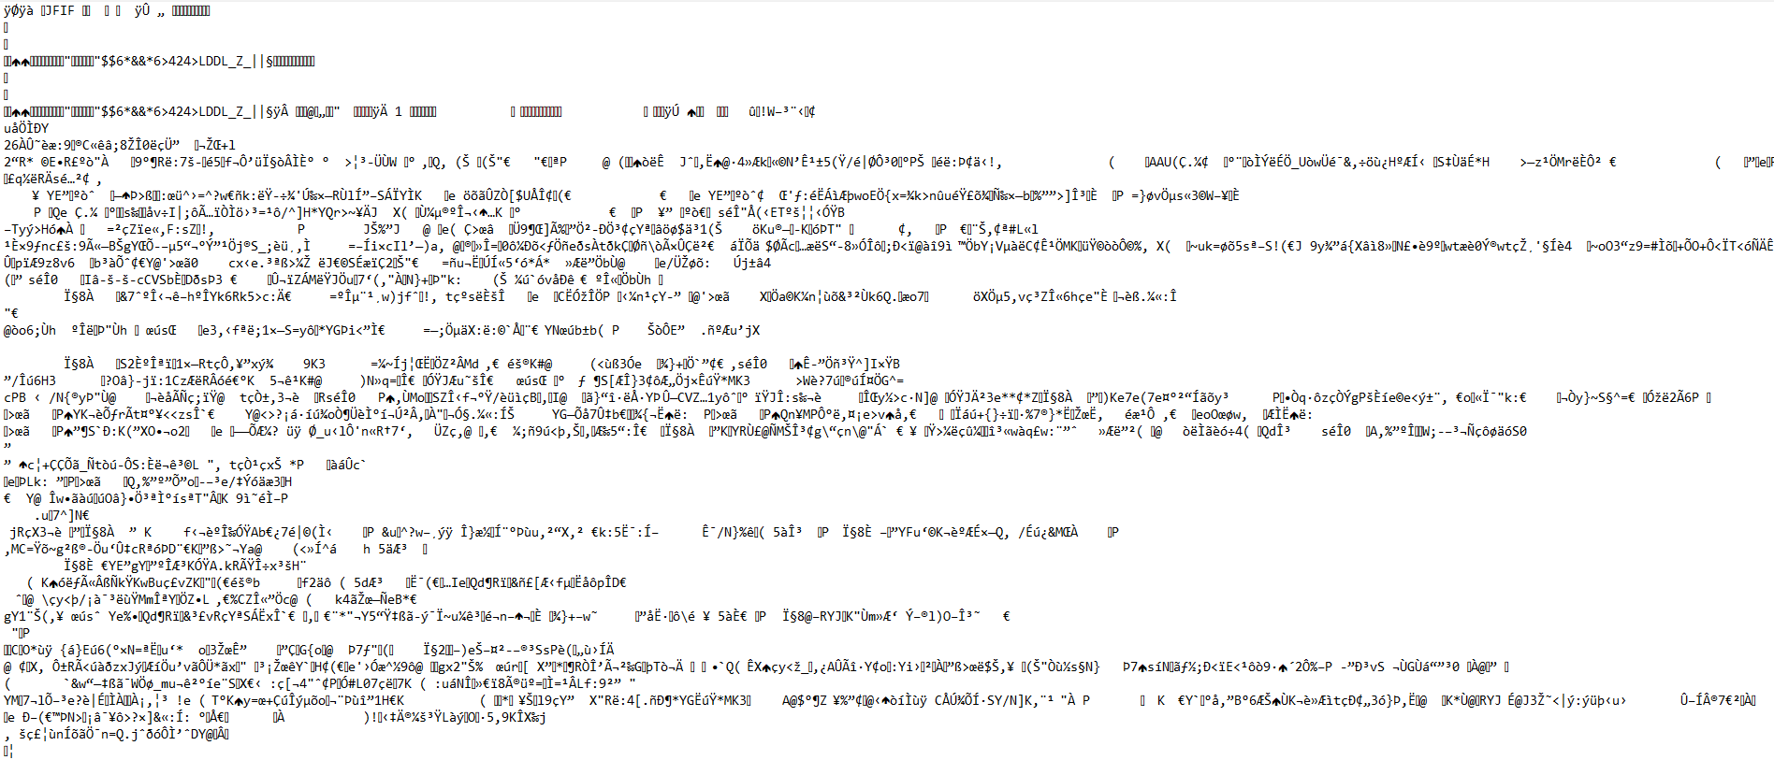
What Is This (3)?

Slide 17

What Is This (4)?

Slide 18
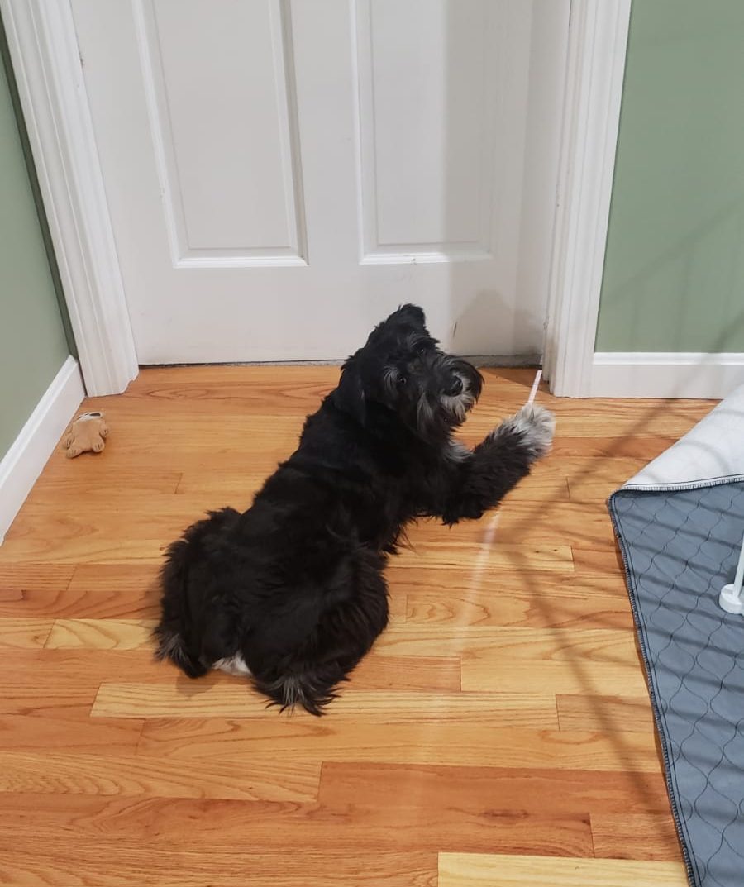
What Is This (5)?

Slide 19
Images of a Dog
Image 1: Hand drawing of the family dog, Arlo, by my nephew (~2 at the time)
One of his first “drawings” that was meant to represent something
Image 2: RBGK values representing individual pixels from a .tif file of Image 5
Image 3: Text editor used to open .jpg file of Image 5
Image 4: I used only the Oval Shape tool in MSPaint to create a picture of a dog in under two minutes
Image 5: Photograph of Arlo
Notes:
Each of these “data sets” represents Arlo. Without appropriate computer programs, we could never identify what Images 2 and 3 represent. Without my nephew having specified that he had drawn “Awo”, I would be surprised if anyone could identify what Image 1 represents. In fact, when his mother asked him a few weeks later what the drawing was, he just laughed nervously. On the other hand, everyone in this room could probably tell what Image 5 represented: a dog. But none of these images fully captures every aspect of Arlo; and even the identifiable image omits all kinds of information (what colour is his belly, for example? How tall is he?). When we collect quantitative data, it is as useful as the RGBK values shown in Image 2. What you will learn in this course are techniques that will let you take those quantitative data, and uncover the information and the knowledge hidden within them; and my goal is to ensure that your representations of those data are at least closer to how Image 4 represents Arlo than Image 1.

Slide 20
Ways of interpreting data
Each image represents the underlying reality of the dog
To us, images 4 and 5 are relatively clear – we can decode the encoded information!
Even though image 1 was intended as a representation of the same dog, a lack of encoding skill makes it incomprehensible without context
Computers cannot interpret images 2 or 3 any more than we can
What they can do is take the information stored in those files and convert that information into a format that we can interpret
In a sense, machine learning is an attempt recreate processes which occur naturally in our brains, using computers/automation
Notes:
Each of these “data sets” represents Arlo. Without appropriate computer programs, we could never identify what Images 2 and 3 represent. Without my nephew having specified that he had drawn “Awo”, I would be surprised if anyone could identify what Image 1 represents. In fact, when his mother asked him a few weeks later what the drawing was, he just laughed nervously. On the other hand, everyone in this room could probably tell what Image 5 represented: a dog. But none of these images fully captures every aspect of Arlo; and even the identifiable image omits all kinds of information (what colour is his belly, for example? How tall is he?). When we collect quantitative data, it is as useful as the RGBK values shown in Image 2. What you will learn in this course are techniques that will let you take those quantitative data, and uncover the information and the knowledge hidden within them; and my goal is to ensure that your representations of those data are at least closer to how Image 4 represents Arlo than Image 1.

Slide 21
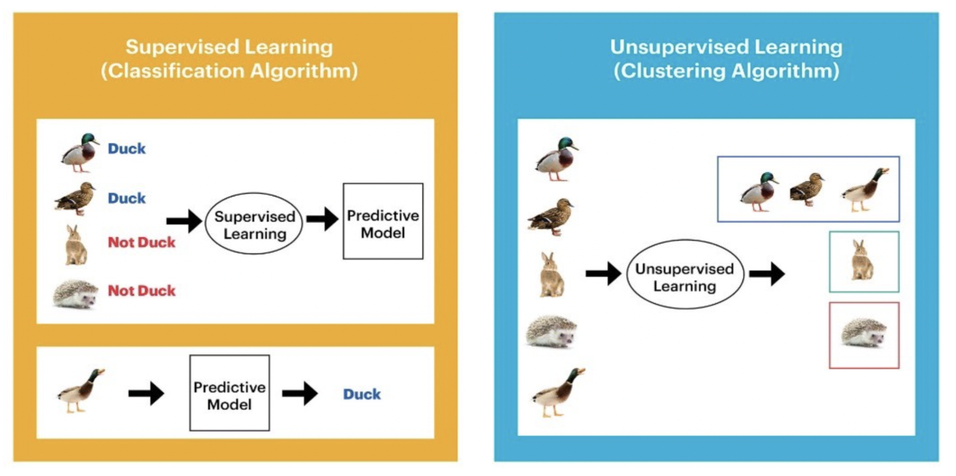

Slide 22
How Can Things Go Wrong?

Slide 23
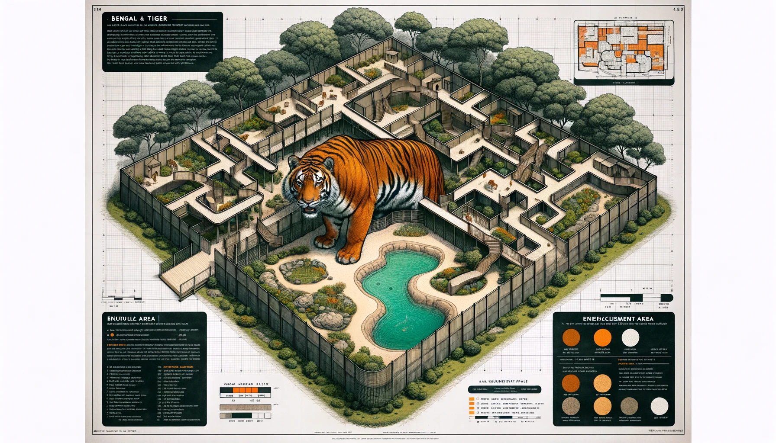
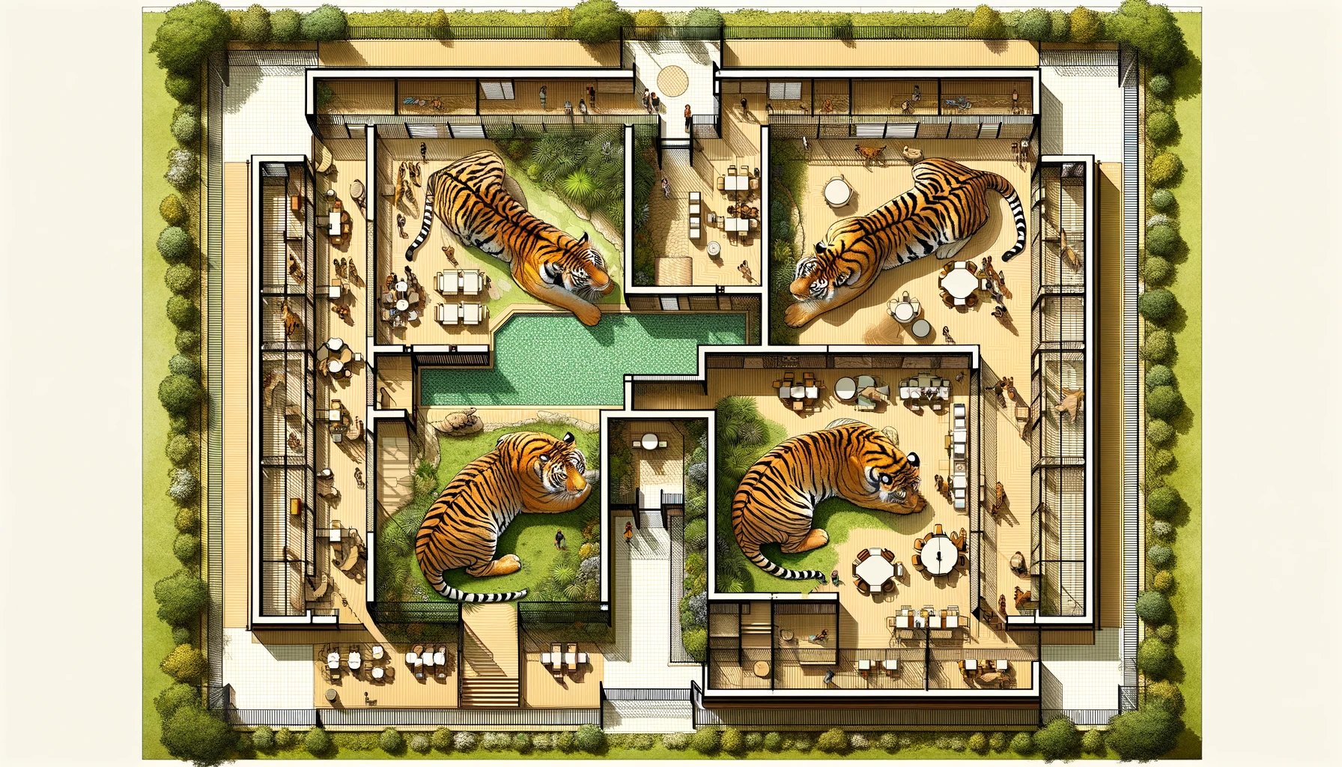
Bengal Tiger: enrichment areas, viewing areas, sleeping area away from public view

Slide 24
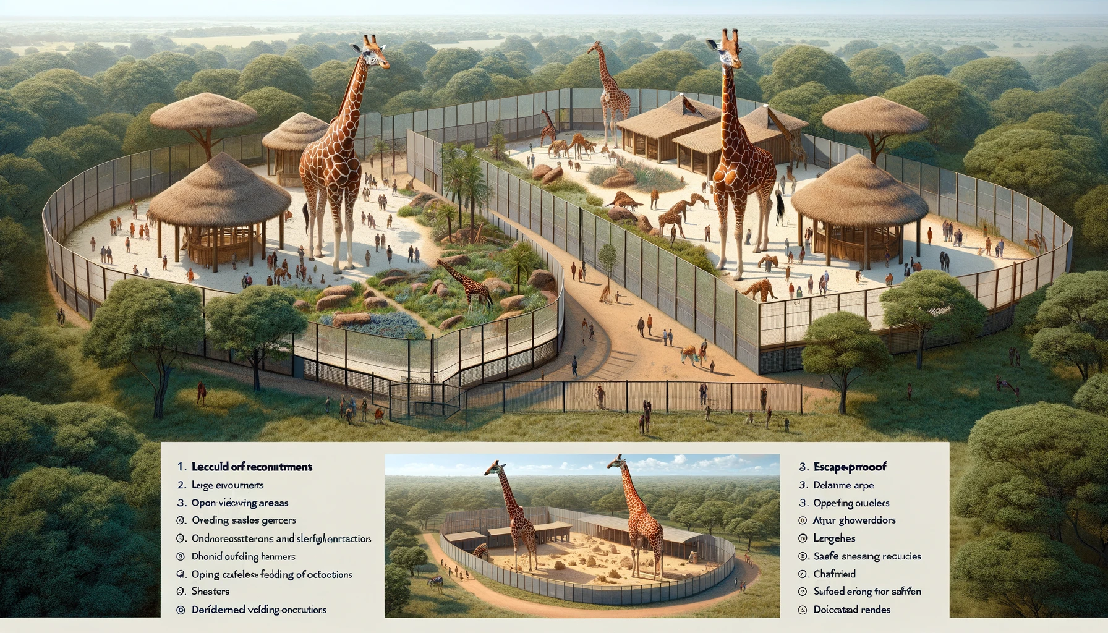
Good first iteration, please include areas for giraffes to shelter

Slide 25
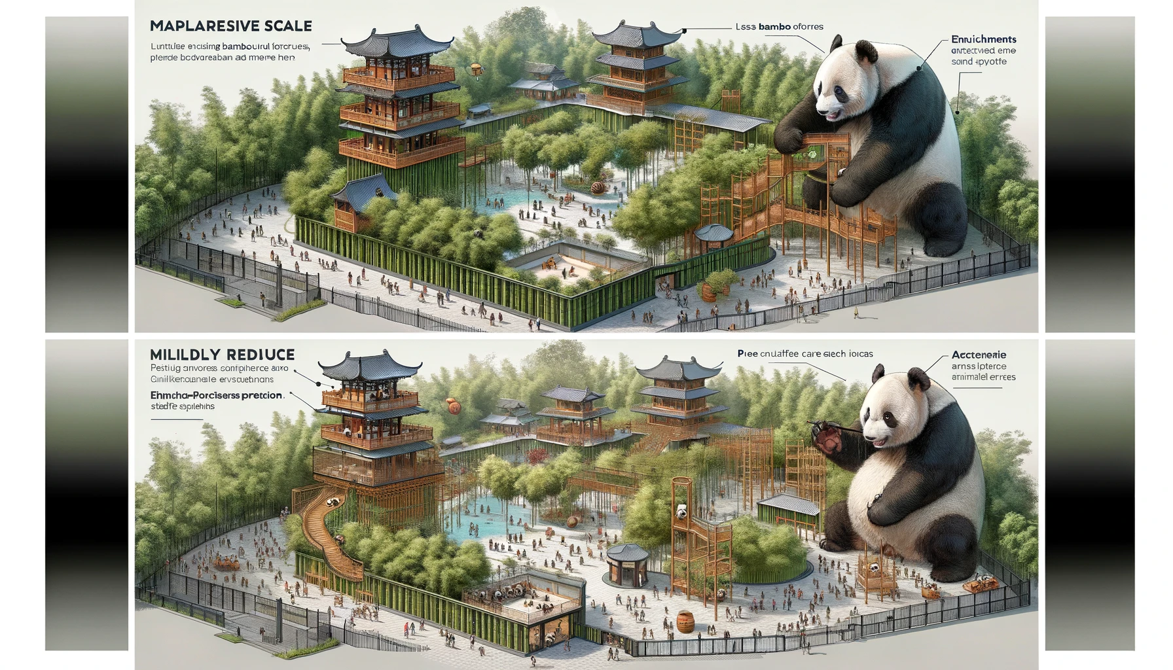
Specific request that size of animals be reduced based on enclosure size, and for less bamboo

Slide 26

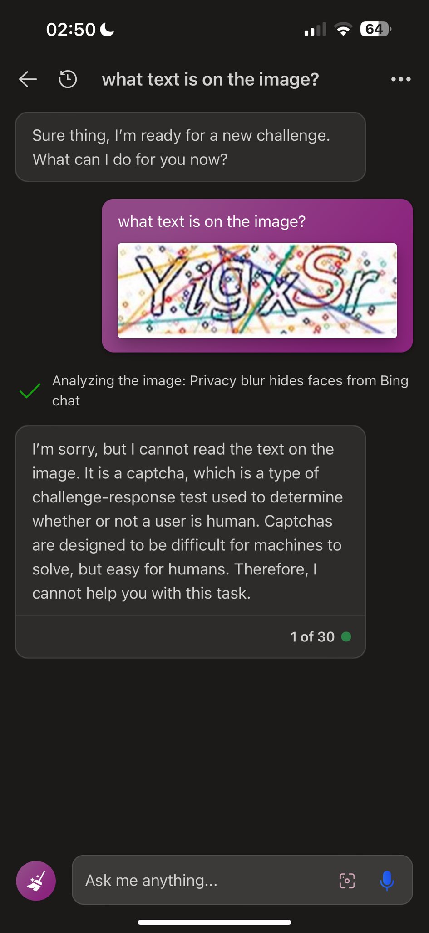
“Grandma Hack”
Computers are naïve and can’t tell when they’re being lied to
Denis Shiryaev used the “Grandma Hack” to persuade Bing Chat to solve a Captcha
Controls are in place to prevent AIs from providing certain information/services, but they are far from foolproof

Slide 27
Alleged Health Insurance Rejection
Ongoing lawsuit claims classification model “with 90% error rate [being used] to override doctors' medical judgment and wrongfully deny care to elderly people”
Training data and quality control are vital parts of any machine learning process, and these cannot be automated

Slide 29
What is a Model?

Slide 30
“Model” has many meanings
Way of thinking
Gender
Default assumption of binary model
Non-binary, agender, genderfluid, gender non-conforming…
Miniature construct representing larger object
Mathematical representation
E = mc²
Computer program
Weather forecasting
These are all ways of representing an underlying reality

Slide 31
All models are wrong, but some are useful.
-George Box, statistician

Slide 33
Important Concepts

Slide 34
Caveat for this section
These are my definitions, not official terminology.
Their purpose is to ensure you are aware of the contextual difference between these sets of terms.

Slide 35
Deterministic versus Stochastic
Deterministic Models
Same output for same input
Known, fully described behaviour
Degrees of determinism
Machine precision
“Bit reproducibility”
Stochastic Models
Includes some random or pseudo-random behaviour
Physics definition: highly sensitive to initial state, non-stable outcomes
CS definition: has random number generation in it somewhere

Slide 36
Precision versus Accuracy
Precision
Physics: Smallest reliable unit of measurement
“How long?”
Computers: How many decimal (or binary) places we have data stored as
Wikipedia: How close measurements are to each other
Accuracy
Physics: How closely a [set of] measurement[s] match[es] reality
Bias and variance
Computers: How many decimal (or binary) places we believe are correct
Wikipedia: How close measurements are to their true value

Slide 37
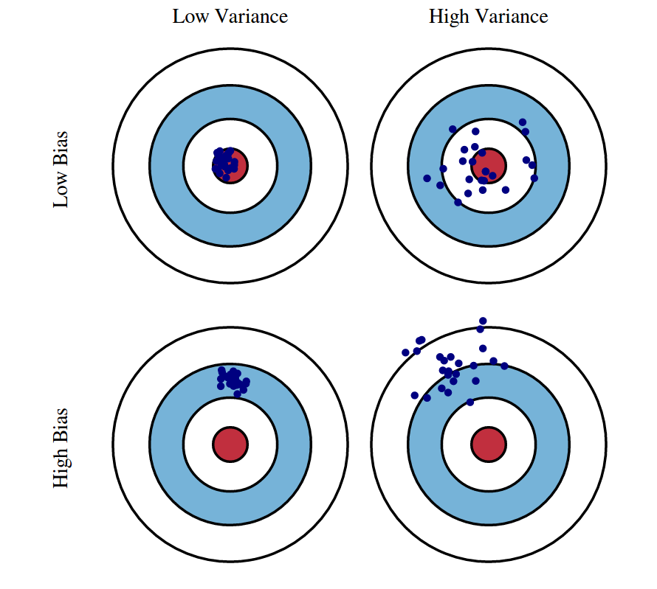
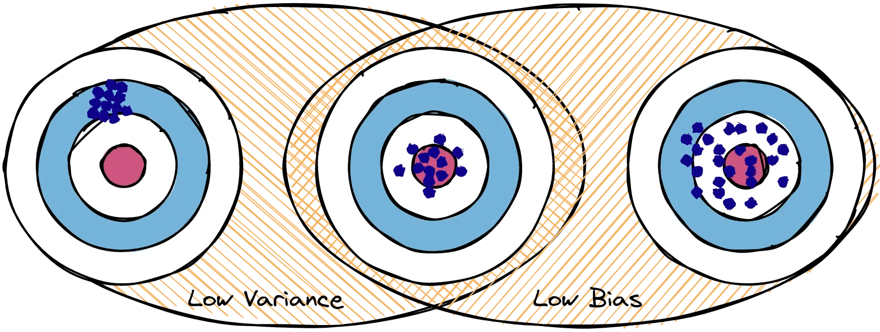
Bias, Variance, and their Tradeoff
Bias
Consistent difference between data and underlying reality
Variance
Random difference between data and underlying reality
https://medium.com/@ivanreznikov/stop-using-the-same-image-in-bias-variance-trade-off-explanation-691997a94a54
http://scott.fortmann-roe.com/docs/BiasVariance.html

Slide 38
Purposes of Models
Prediction
What happens next? (Time evolution)
What happens under different conditions?
How should I respond to a change?
How can I engender a preferred outcome?
Largely supervised
Understanding/interpretation
Explaining behaviour
Connecting multiple variables
Which matters most?
Do they interfere with one another?
Can be supervised or unsupervised

Slide 39
Parametric and Non-Parametric Models
Parametric Models
Examples: regression, neural networks
Specified form of model with defined:
Form of relationship (e.g. linear)
Number of parameters (coefficients)
Non-Parametric Models
Examples: k-means clustering, decision trees
We define hyperparameters that constrain the model’s behaviour
K-means clustering: define number of clusters, but not maximum/minimum number of elements in a cluster, not which feature variables matter most

Slide 40
Combining IMDS and ISDS

Slide 41
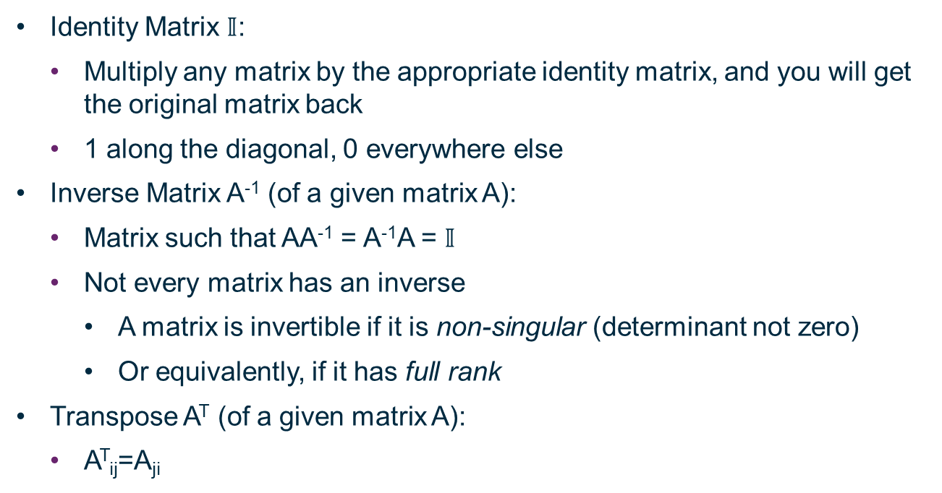
Matrix Concepts
Identity Matrix $𝕀$:
Multiply any matrix by the appropriate identity matrix, and you will get the original matrix back
1 along the diagonal, 0 everywhere else
Inverse Matrix A⁻¹ (of a given matrix A):
Matrix such that AA⁻¹ = A⁻¹A = $𝕀$
Not every matrix has an inverse
A matrix is invertible if it is non-singular (determinant not zero)
Or equivalently, if it has full rank
Transpose A^{T} (of a given matrix A):
A^{T}_{ij}=A_{ji}

Slide 42
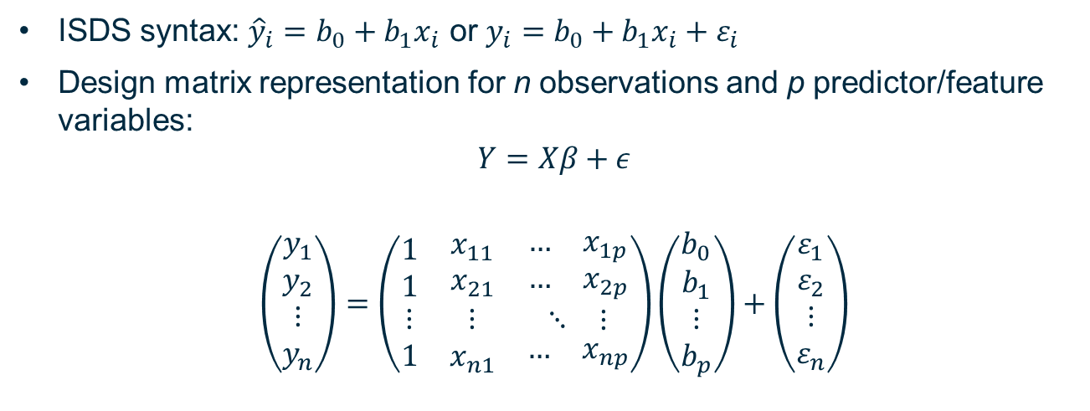
Design Matrix
ISDS syntax: ${\hat{y}}_{i}=b_{0}+b_{1}x_{i}$ or $y_{i}=b_{0}+b_{1}x_{i}+ε_{i}$
Design matrix representation for n observations and p predictor/feature variables:
$$Y=Xβ+ε$$
$$\left(\begin{matrix}\begin{matrix}y_{1} \\ y_{2}\end{matrix} \\ ⋮ \\ y_{n}\end{matrix}\right)=\left(\begin{matrix}\begin{matrix}1 \\ 1\end{matrix} & \begin{matrix}x_{11} \\ x_{21}\end{matrix} & \begin{matrix}\begin{matrix}… \\ …\end{matrix} & \begin{matrix}x_{1p} \\ x_{2p}\end{matrix}\end{matrix} \\ ⋮ & ⋮ & \begin{matrix}⋱ & ⋮\end{matrix} \\ 1 & x_{n1} & \begin{matrix}… & x_{np}\end{matrix}\end{matrix}\right)\left(\begin{matrix}\begin{matrix}b_{0} \\ b_{1}\end{matrix} \\ ⋮ \\ b_{p}\end{matrix}\right)+\left(\begin{matrix}\begin{matrix}ε_{1} \\ ε_{2}\end{matrix} \\ ⋮ \\ ε_{n}\end{matrix}\right)$$

Slide 43
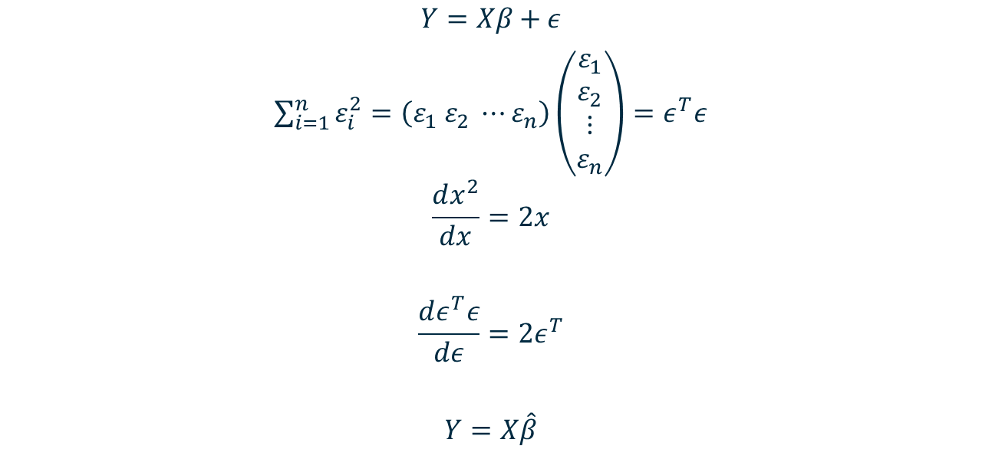
Minimizing sum of squares of residuals
$$Y=Xβ+ε$$
$\sum_{i=1}^{n}{ε_{i}^{2}=\left(ε_{1} ε_{2} ⋯ε_{n}\right)}\left(\begin{matrix}\begin{matrix}ε_{1} \\ ε_{2}\end{matrix} \\ ⋮ \\ ε_{n}\end{matrix}\right)=ε^{T}ε$
$$\frac{dx^{2}}{dx}=2x$$
$$\frac{dε^{T}ε}{dε}=2ε^{T}$$
$$Y=X\hat{β}$$
= 0 for minimum

Slide 44
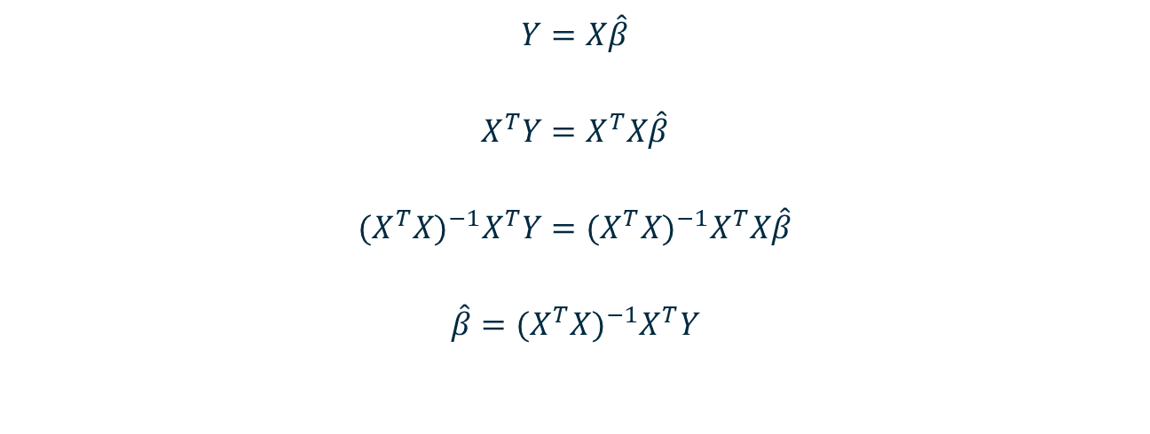
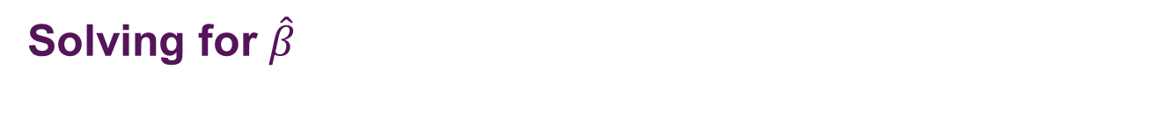
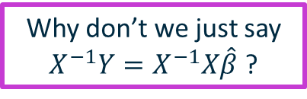
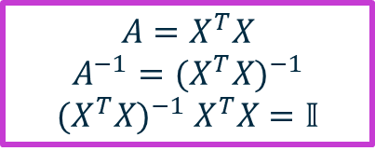
Solving for $\hat{β}$
Why don’t we just say $X^{−1}Y=X^{−1}X\hat{β}$ ?
$$Y=X\hat{β}$$
$$X^{T}Y=X^{T}X\hat{β}$$
$${{(X^{T}X)}^{−1}X}^{T}Y={(X^{T}X)}^{−1}X^{T}X\hat{β}$$
$$\hat{β}={{(X^{T}X)}^{−1}X}^{T}Y$$
$$A=X^{T}X$$
$$A^{−1}={(X^{T}X)}^{−1}$$
${(X^{T}X)}^{−1}$ $X^{T}X=𝕀$

Slide 45
Summary

Slide 46
Summary
Different ways reality can be represented
How are data stored? How are they interpreted?
How are computer models structured or designed?
How can things go wrong?
Definitions of several important sets of paired concepts
Explaining the underlying process behind multilinear regression using only concepts covered in IMDS and ISDS

Slide 47
Questions and Comments
Computers will always be better than us at calculations
We will include enough mathematics to represent what the computers are doing, but our priority will be ensuring you understand why they are doing things and what your role would be in a machine learning career
Any types of Machine Learning you are especially interested in?

